Slide 1
Memory Management
Mm techniques, contiguous and no contiguous, fixed partitioning ,variable partitioning, paging, segmentation,

Slide 2
Memory Management Requirements
Process Isolation: Prevents interference between processes.
Automatic Allocation and Management: OS dynamically allocates and deallocates memory.
Support for Modular Programming: Simplifies coding and debugging by managing modules separately.
Protection and Access Control: Safeguards processes from unauthorized access.

Slide 3
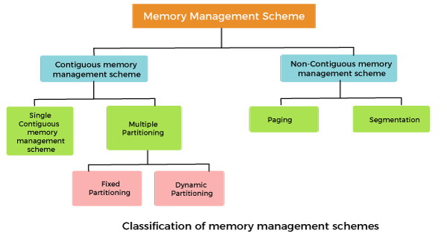
Memory Management Techniques

Slide 4
Contiguous Memory Allocation
Definition: Entire process must be allocated a single contiguous block of memory.
Advantages:
Simple implementation.
Easy address translation (base address + offset).
Disadvantages:
External Fragmentation: Free spaces may not be usable due to their scattered nature.
Inefficient for large, dynamic processes.
Example: A process of size 100MB requires a contiguous 100MB block, even if sufficient total free memory is scattered.

Slide 5
Non-Contiguous Memory Allocation
Definition: Process is divided into smaller blocks (pages or segments) that can be allocated in non-contiguous memory locations.
Advantages:
Eliminates external fragmentation.
Efficient use of memory.
Disadvantages:
More complex address translation.
Overhead due to maintenance of page/segment tables.
Example: Process pages are spread across available memory frames.

Slide 6
Fragmentation and Solutions
Internal Fragmentation: Wasted space within allocated memory blocks.
External Fragmentation: Scattered free space between allocations.
Solutions:
Paging eliminates external fragmentation.
Compaction consolidates free spaces.

Slide 7
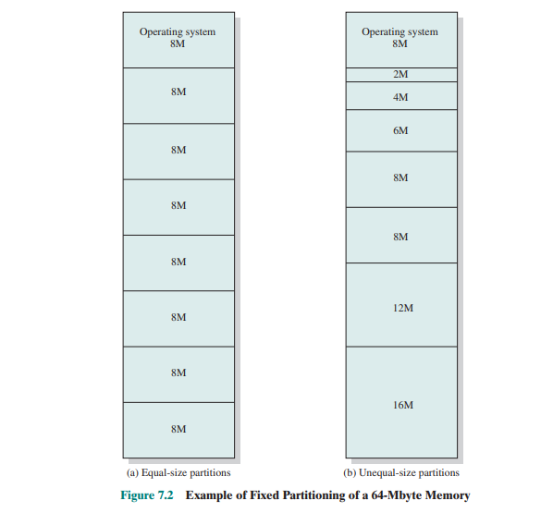
Fixed Partitioning
Definition: Divides memory into pre-defined, fixed-sized partitions.
Advantages: Simple implementation, predictable behavior.
Disadvantages: Wasted space due to internal fragmentation.
Internal Fragmentation: Occurs when allocated memory is larger than required by a process, resulting in wasted space within a partition.
Example: Process A (100MB) occupies a 256MB partition; 156MB wasted.

Slide 8
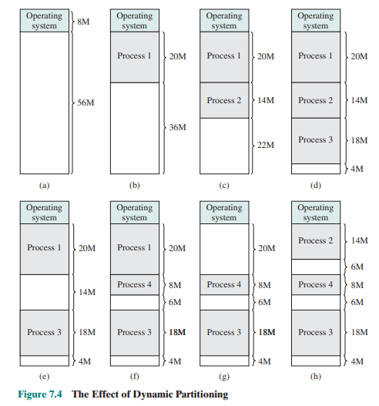
Dynamic Partitioning
Definition: Allocates memory based on process size.
Advantages: No internal fragmentation.
Disadvantages: External fragmentation occurs as free memory fragments.
Solution: Compaction to consolidate memory blocks.

Slide 9
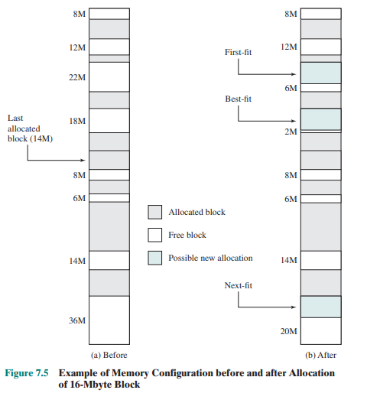
Placement Algorithms
First Fit: Allocates the first available block of memory that is large enough.
Best Fit: Allocates the smallest block that satisfies the request, minimizing wasted space.
Worst Fit: Allocates the largest available block, leaving the largest leftover hole.
Trade-offs:
First Fit: Fast but may cause fragmentation.
Best Fit: Efficient use of space but slower and can increase fragmentation.
Worst Fit: Avoids small fragments but wastes large memory blocks

Slide 10
Paging
Definition: Divides memory into fixed-size frames and processes into pages.
Benefits: Eliminates external fragmentation, supports non-contiguous allocation.
Challenges: Page faults occur when a page is not in memory.

Slide 11
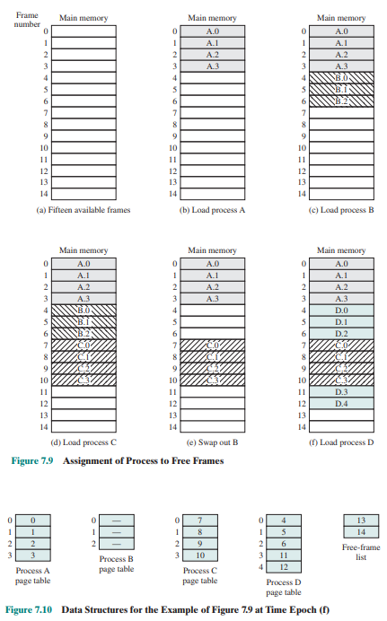
Paging

Slide 12
Paging - Address Translation
Logical Address: A user-generated address within the program's address space.
Physical Address: The actual location in main memory where data resides.
Uses a page table to map logical to physical addresses.
Page Faults: Managed by loading the missing page from disk into memory.

Slide 13
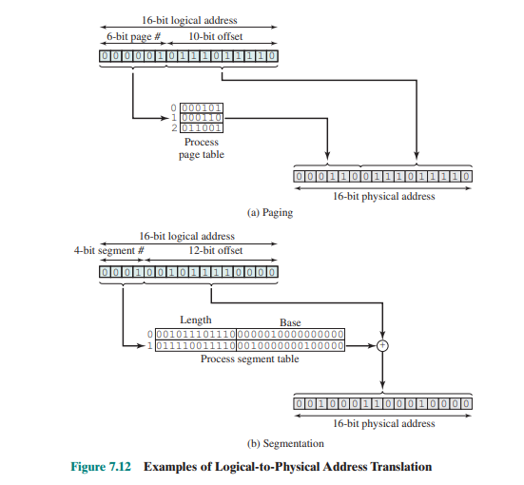
Examples of Logical-to-Physical Address Translation

Slide 14
Segmentation
Definition: Divides memory into logical segments (e.g., code, data, stack).
Advantages: Reflects program structure, supports variable-sized segments.
Disadvantages: Susceptible to fragmentation.

Slide 15
Segmentation - Address Translation
Logical Address: .
Physical Address: Derived using a segment table:
Base Address: Start of the segment.
Limit: Maximum segment size.

